Slide 1

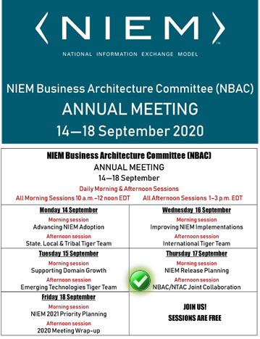
Virtual Annual Meeting (NBAC)
17 September 2020 → 1 - 3PM
NBAC/NTAC Collaboration Planning

Slide 2
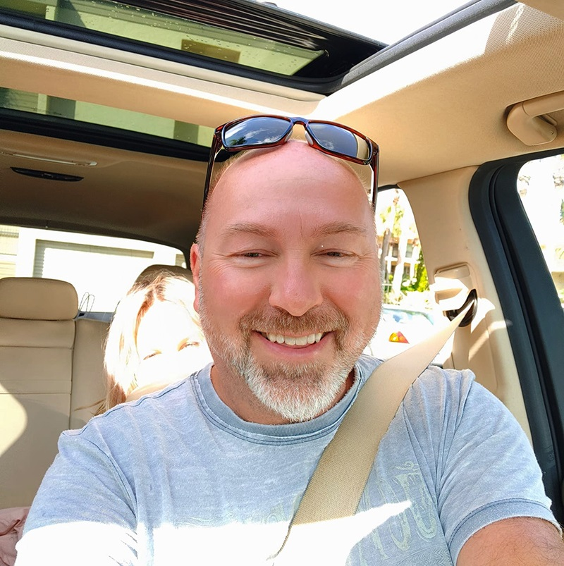

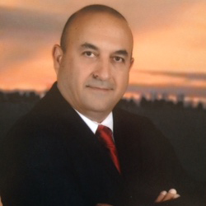

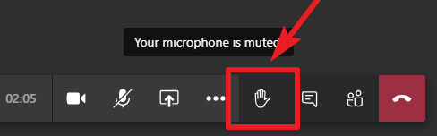

Housekeeping
HOUSEKEEPING:
MUTE your mic when you’re not talking
Identify yourself before you start to speak
Speak clearly
Disable “call waiting” feature (the clicking noise can be heard by all)
Please note: All 2020 sessions are audio recorded for NIEM training & communications purposes
QUESTIONS & ANSWERS ARE ENCOURAGED!
To signal you want to contribute without interrupting the speaker
Enter comments via CHAT window at any time
To signal a question or respond to a question
Click on ‘Raise your hand’ button on meeting toolbar
(Lower hand after you’ve talked by clicking hand button again)
All session briefings are available on NIEM’s GitHub for download as they occur
Speakers
Thomas Krul
Kamran Atri
https://github.com/NIEM/NIEM-Annual-Meetings/tree/master/2020
2

Slide 3






What we accomplished this week
Advance NIEM Adoption
US VA – CDO - Kshemendra Paul
Support NIEM Domain Growth
US DHS CISA – CTO - Brian Gattoni
Improving NIEM Implementation
CA TBS – Johnathan Kirk
NIEM Release Planning
NIEM 2021 Priority Planning
3

Slide 4

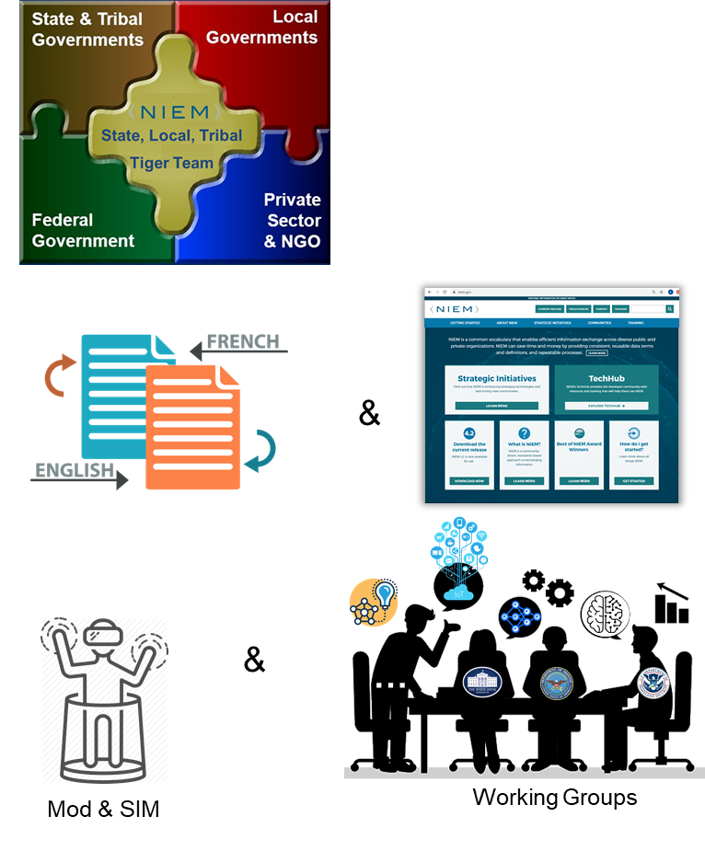




Mobilizing NIEM Teams (2020)
State, Local, and Tribal Tiger Team
Co-Chair: Cait Ryan / Tom Carlson
International Tiger Team
Co-Chair: Thomas Krul / Kamran Atri
Emerging Technologies Tiger Team
Chair: Jalal Mapar, Co-Chair: Lain McNeill
IEPD Registry TT
Eric Sweden
Requirements for Design Review
Poewan Lau
Syed Mohammed

Slide 5
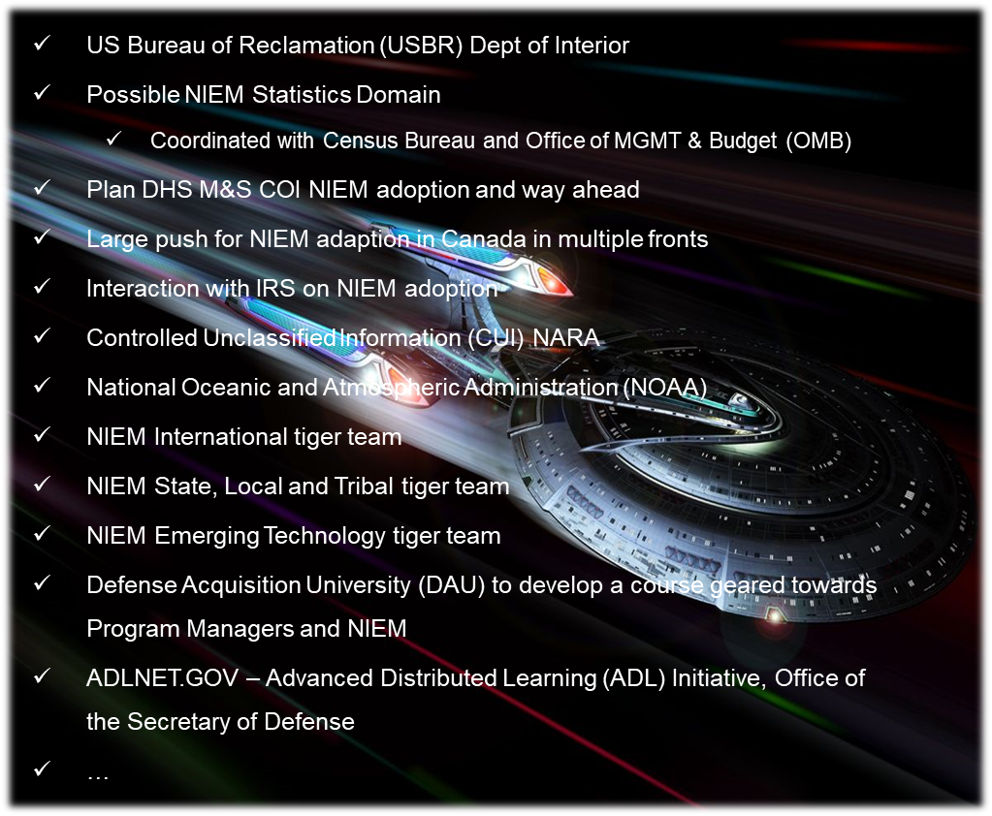
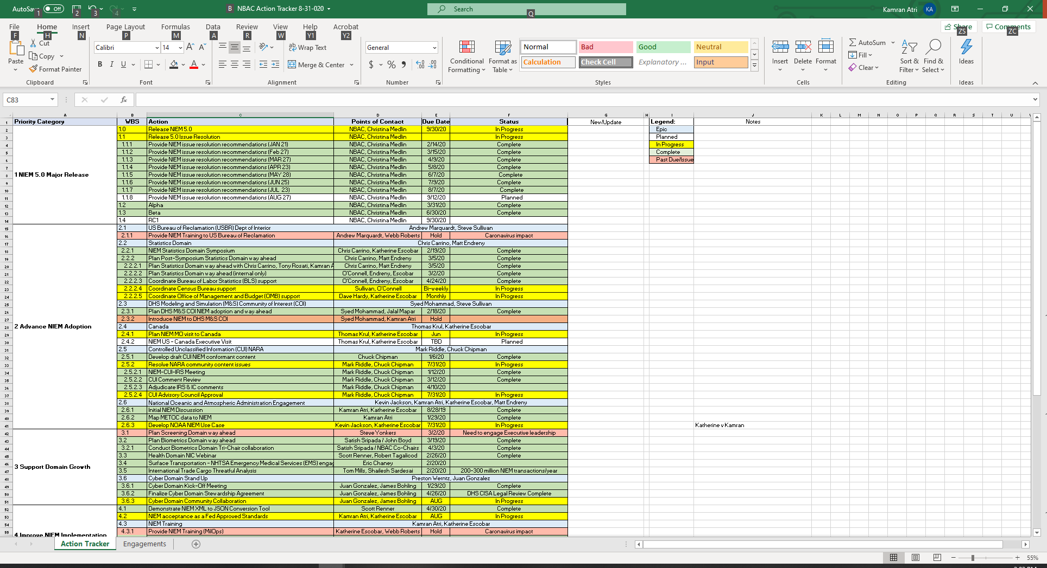

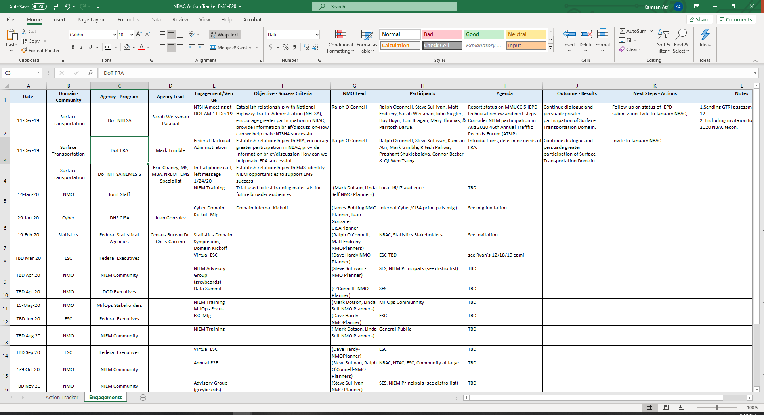
2020 at a glance
NBAC Action Tracker
NIEM Cyber Domain
NBAC Engagements Tracker

Slide 6
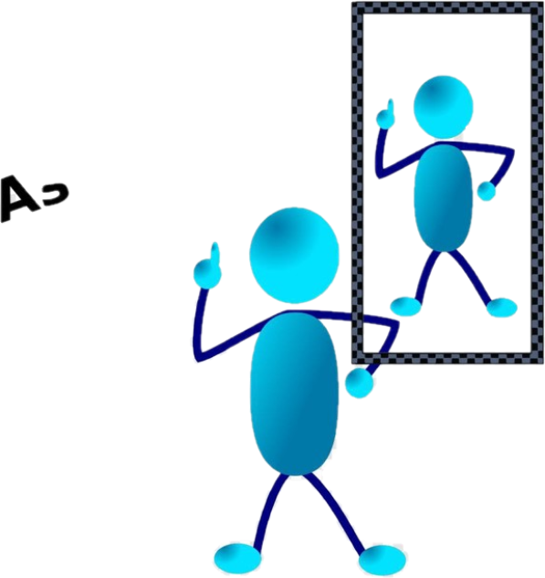






2020 at a glance
NIEM
Domain
2020 NBAC Annual Meeting
Domain Self Assessment
Statistics Domain Onboarding
NIEM 5.0 RC1
Best of NIEM

Slide 7
2021 NBAC work Recommendations
NBAC Monthly Meetings 2021
NBAC Annual Report 2021
Continue with the Tiger Team Initiatives
Revisit NIEM cost model & supporting develop slides demonstrating the cost/benefit of NIEM
Assist NIEM PMO
modernizing the NIEM Training Material
Evaluating the newly structured NIEM Tools
Onboard new NIEM Domain
Assess and support NIEM Registry development

Slide 8
2021 NBAC work Recommendations
Advance NIEM Adoption
Engage GAO and showcase NIEM
Use GAO Report to setup outlier
Support Domain Growth
Consider mentorship program between Domains
Improve NIEM Implementation (including Release plans)
Revisit tools such as Self Assessment
Take Active Role in New Domain Onboarding
Statistics
Health
NOAA
VA
Treasury
Public Works /Safety
Grants
Strengthen NBAC and NTAC Collaboration

Slide 9


Slide 10
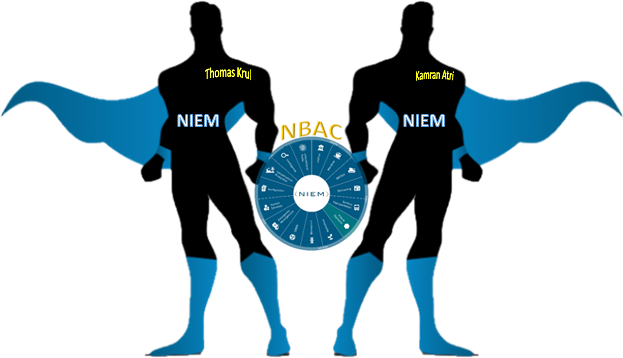
Enabling Connected Future Now
NBAC Co-Chairs
Thomas Krul
Kamran Atri
thomas.krul@canada.ca
katri@A4SAFE.COM
10

Slide 11
Annual Meeting Overview (14-18 September)
NBAC Session | Event Date/ Time | Topic | Primary Facilitator (s) | Support Facilitator (s) | Guest Speaker (s)
1 | Monday, 14 SEP 10 - 12 AM | Advance NIEM Adoption | Kamran Atri | Thomas Krul | Kshmendra Paul
2 | Monday, 14 SEP 1 - 3 PM | State, Local, Tribal Tiger Team | Cait Ryan / Tom Carlson | Thomas Krul | Eric Sweden (NASCIO)
3 | Tuesday, 15 SEP 10 - 12 AM | Support Domain Growth | Kamran Atri | Thomas Krul | Brian Gattoni (DHS CISA CTO)
4 | Tuesday, 15 SEP 1 - 3 PM | Emerging Technologies Tiger Team | Jalal Mapar | Lain McNeill | Syed Mohammed
5 | Wednesday, 16 SEP 10 - 12 AM | Improve NIEM Implementation | Thomas Krul | Kamran Atri | Dr. Paul Flynn (JNKE)
6 | Wednesday, 16 SEP 1- 3 PM | International Tiger Team | Thomas Krul | Kamran Atri | Poewan Lau
7 | Thursday, 17 SEP 10 - 12 AM | NIEM Release Planning | Christina Medlin | TBD | N/A - Working Session
8 | Thursday, 17 SEP 1- 3 PM | NBAC/NTAC Collaboration Planning | Kamran Atri/ Web Roberts | Thomas Krul/ Dr. Scott Renner | N/A - Working Session
9 | Friday, 18 SEP 10 - 12 AM | NIEM 2021 Priority Planning | Katherine Esobar | Stephen Sullivan | Stuart Whitehead
10 | Friday, 18 SEP 12 -12:15 PM | WRAP-UP/Adjourn | Kamran Atri / Thomas Krul | Stephen Sullivan | N/A

